Slide 1
WELCOME!
European Citizens’ Initiative Forum Webinar:
What is the ECI and Why Should I Care?
Host: Vasiliki Mustakis
Participatory Democracy Coordinator, European Citizen Action Service (ECAS)
23 November 2023

Slide 2
Today’s Agenda
LEARN
Introduction and Welcome (5 minutes)
Presentation by ECI Policy Officer, Barbara Walentynowicz on the official procedural steps of the ECI (10 minutes)
Presentation by ECI Organiser, Elise Fleury, Fur Free Europe, to give their perspective on the ECI as a participatory democracy tool (10 minutes)
Presentation by ECI Organiser, Nils Kluger, Stop Finning – Stop the Trade to give their perspective on the ECI as a participatory democracy tool (10 minutes)
Presentation by Vasiliki Mustakis on the support tools available to organisers (10 minutes)
Q&A (15 minutes)
Closing remarks

Slide 3
Speakers
LEARN
Elise Fleury
Fur Free Europe, ECI Organiser
Nils Kluger
Stop Finning – Stop the Trade, ECI Organiser
Barbara Walentynowicz
Policy Officer – European Citizens’ Initiative, European Commission

Slide 4
What is the
European Citizens’ Initiative Forum?
The Forum supports organisers in the preparatory phase and during the collection of signatures of their initiative!
An online collaborative platform (available in all 24 EU languages) that provides advice and information to initiative organisers before, during and after the process of launching and implementing an initiative
LEARN
SEEK ADVICE
DISCUSS
CONNECT
https://citizens-initiative-forum.europa.eu/_en

Slide 5
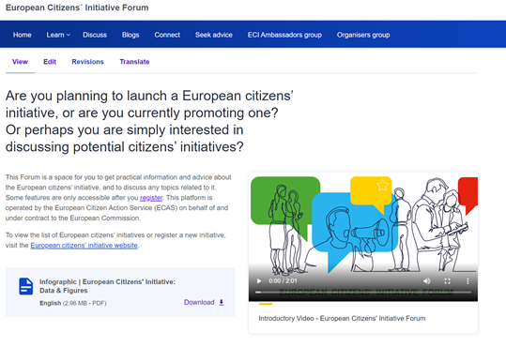
LEARN
An essential tool for organising an initiative!
Learn Section: Webinars, Guidance Notes, Learning Material, Testimonials
Blogs
Discuss
Seek Advice: if an organiser needs legal, campaigning or fundraising advice during their campaign
* You must register to access certain features of the ECI Forum

Slide 6
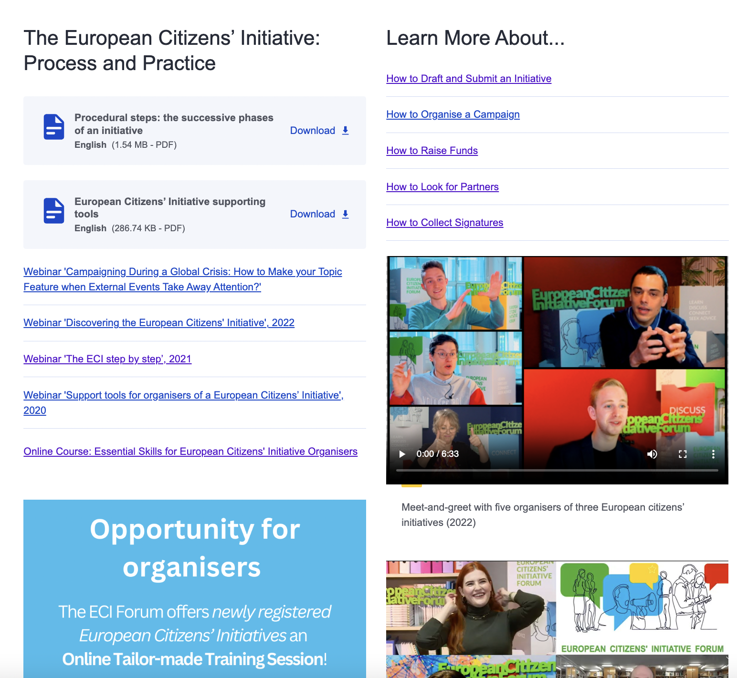
hl
Explore the Learning Resources on the Forum
LEARN
In the Learn section of the ECI Forum, you can find all the resources you need to manage your ECI, such as guidance notes, success stories, webinar recordings, testimonials from ECI organisers and other learning materials.
Explore the learning resources divided by subsection:
How to Draft and Submit an Initiative
How to Organise a Campaign
How to Raise Funds
How to Look for Partners
How to Collect Signatures
Success Stories

Slide 7
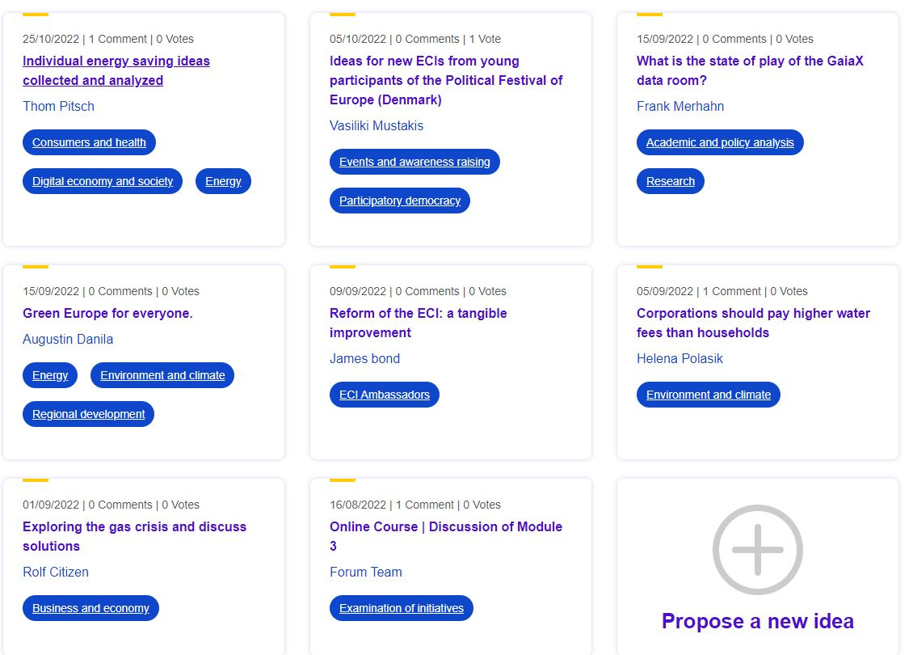
DISCUSS
Discuss with other ECI Forum users!

Slide 8
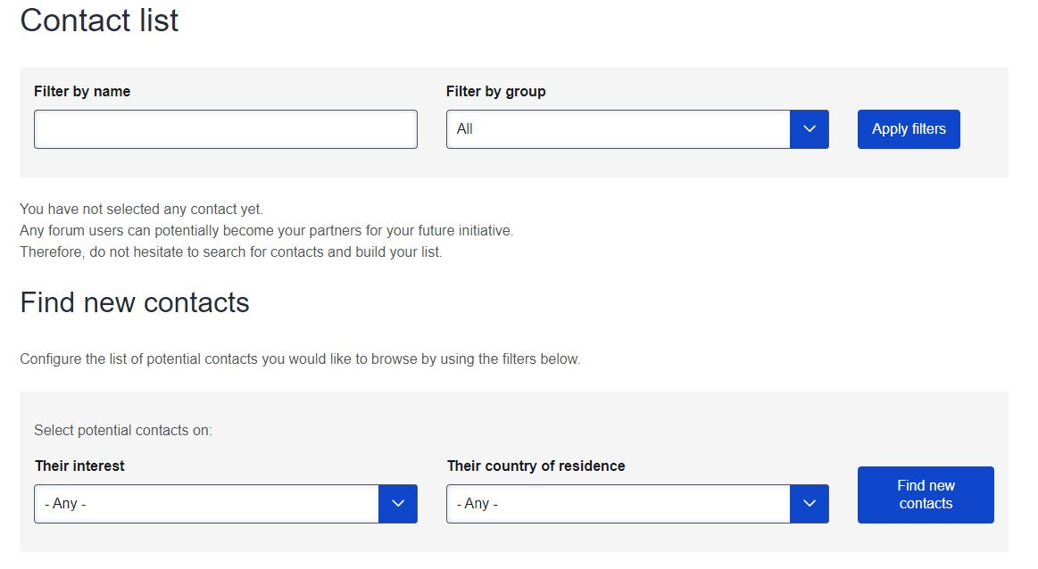
CONNECT
Connect with other ECI Forum users!

Slide 9
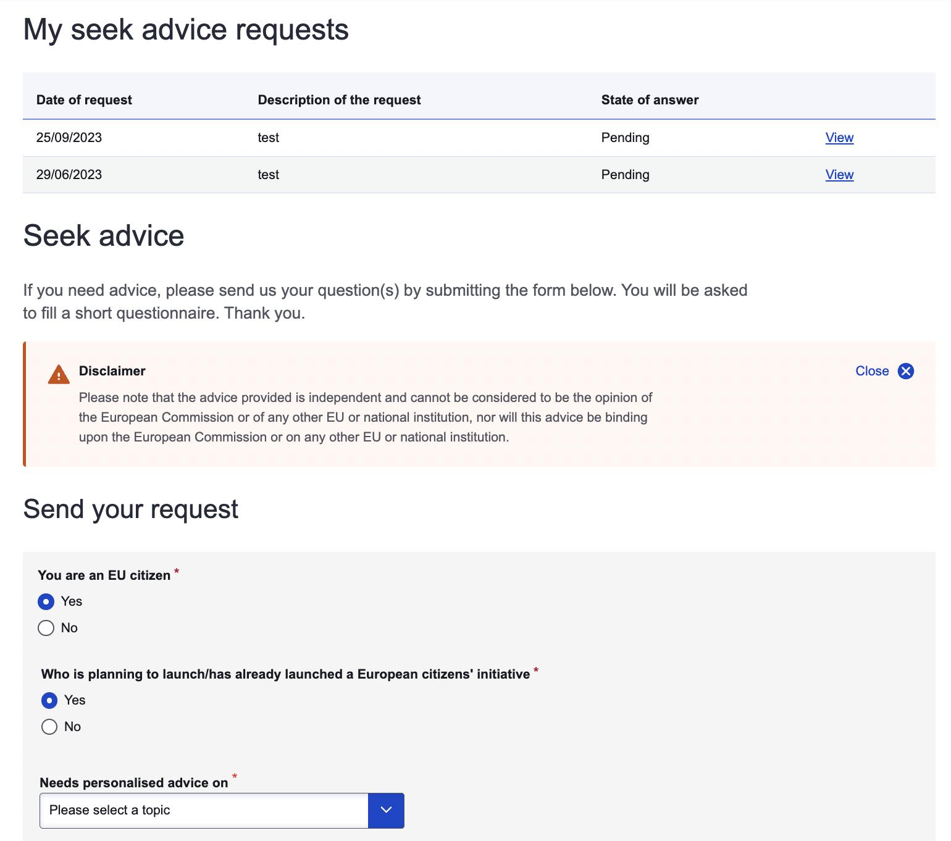
SEEK ADVICE
Tailor-made and independent advice to potential and/or current organisers of the European Citizens’ Initiatives on
Legal,
Campaigning,
Fundraising,
Other ECI related issues
This advice is free to all users of the Forum
Experts of each topic provide answers to each enquiry sent through the seek advice.

Slide 10
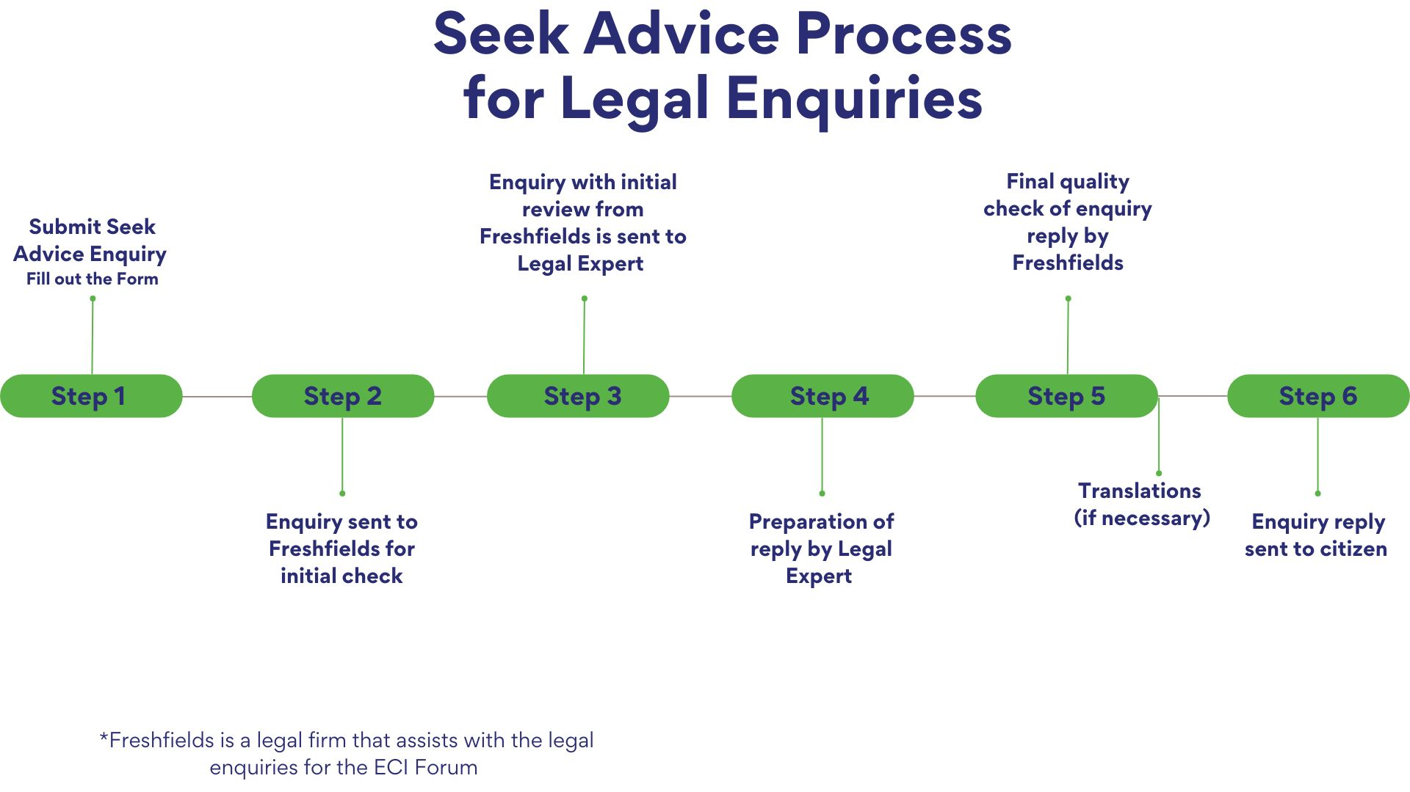
SEEK ADVICE

Slide 11
Opportunities for Organisers
LEARN
ECI Forum Welcome Call
Tailor-made Online Training Session for newly registered ECIs which includes an overview of the signature collection process, the support tools available and campaigning advice.
Blog Post
The ECI Forum provides a platform for ECI organisers to share their experiences and insights at different stages of the initiative process through informative blog posts, fostering a valuable exchange of knowledge within the ECI Forum community.
Interview for ECI Forum Video
Want to be featured on the ECI Forum? We are constantly looking for ECI organisers to interview to promote their ECI and their experience in launching an ECI.

Slide 12
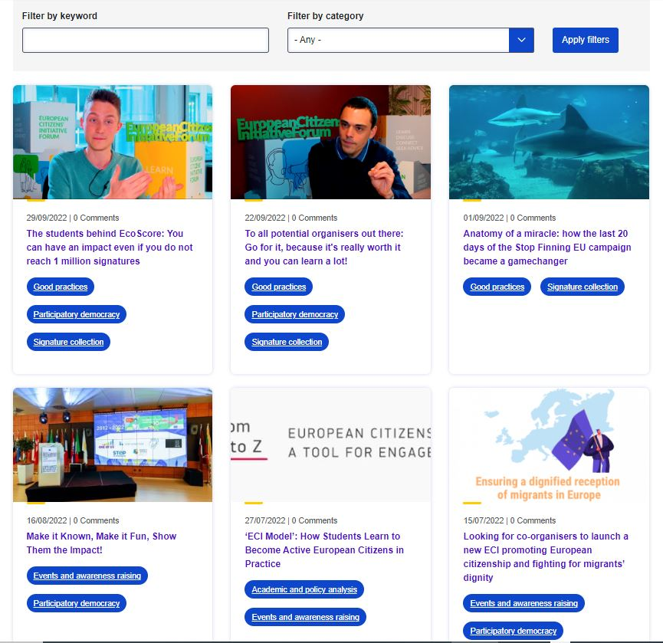
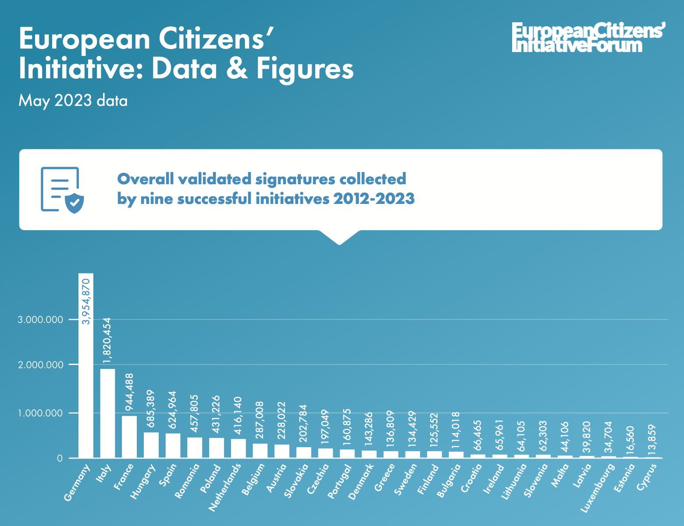
Other Resources on the Forum
LEARN
Blogs
ECI Infographic 2022
Online course Citizens can learn more about the European Citizens' Initiative by joining our online course: Essential Skills for European Citizens' Initiative Organisers

Slide 13
For more information
LEARN
Guidance notes
The Central Online Collection System
Procedural steps the successive phases of an initiative
How to look for partners practical tips and hints
How to draft an initiative legal requirements and practical advice
How to campaign common sense advice on promoting your initiative
How to collect signatures is often the hardest step
How to raise funds for your campaign
Success stories – Currently Available on the Forum
One of us pro-life initiative with papal backing
Right2Water the impact of prime-time TV coverage
Stop Glyphosate building on an existing pan-European campaigning network
Stop Vivisection the power of large groups of volunteers
End the Cage Age achieving its goal together with committed partners
Minority SafePack one million signatures for diversity in Europe
Useful links
Other Webinars
European Citizens' Initiative Forum Learn Page
European Citizens’ Initiative Website
Subscribe to the Newsletter

Slide 14
The European Citizens’ Initiative Facebook Group
CONNECT
Introducing a new way to connect and interact with organisers, stakeholders and interested citizens through the European Citizens' Initiative Facebook Group!
Join the group here: https://www.facebook.com/groups/eciofficialgroup

Slide 15
Thank you very much for joining us today!
LEARN
SEEK ADVICE
DISCUSS
CONNECT

