Slide 1
European Citizens’ Initiative
Webinar
ESSENTIAL SKILLS FOR EUROPEAN CITIZENS' INITIATIVE ORGANISERS
THE BASICS
Host: Elisa Lironi
Programme Director - European Democracy, European Citizen Action Service
Daniela Vancic
European Programme Manager – Democracy International
19 October 2022

Slide 2
Outline of today’s webinar
Introduction
Understanding the areas of Commission competences and managing the registration process - Practical aspects of the ECI and what the ECI Forum is.
Campaigning for a European Citizens' Initiative - what has worked well, what needs to be improved.
Support Networks, Fundraising and Advocacy – how to reach 1 million signatures.
Q&A – Interactive Discussion

Slide 3
What is the European Citizens’ Initiative?
Article 11(4) of the Treaty on the European Union:
Not less than one million citizens who are nationals of a significant number of Member States may take the initiative of inviting the European Commission, within the framework of its powers, to submit any appropriate proposal on matters where citizens consider that a legal act of the Union is required for the purpose of implementing the Treaties.
THE FIRST SUPRANATIONAL INSTRUMENT OF PARTICIPATORY DEMOCRACY
Notes:
EU citizens can use this tool to invite the EC to initiate a legislative proposal

Slide 4
The European Citizens’ Initiative & Other Ways to engage
It is an important instrument, because it is the first supranational instrument of participatory democracy and allows citizens to cooperative among themselves
Other ways to engage with the EU:
Online EU Public Consultations
Petitions to the European Parliament
Conference on the Future of Europe – Citizens’ Panels

Slide 5
Launching your initiative
You must first set up a group of organisers composed of at least 7 EU citizens living in 7 different EU countries.
→ What counts is their country of residence. Organisers can have the same or different nationalities.
You must also fulfill the following conditions:
the initiative concerns an issue where the Commission has powers to propose an EU law
the initiative is not abusive, frivolous or offensive
the initiative is in line with (i) EU values, as set out in Article 2 of the Treaty on European Union and (ii) the rights in the EU’s Charter of Fundamental Rights.

Slide 6
Getting your initiative registered
To get the proposed initiative registered you need to set up an organiser account and fill in the required fields with the description of your initiative.
Required fields:
the title of the initiative (max. 100 characters, without spaces)
the objectives of the initiative (max. 1,100 characters without spaces)
the Treaty articles that you as organisers consider relevant for the proposed initiative
the full names, postal addressees, nationalities and dates of birth of 7 group members living in 7 different EU countries

Slide 7
Campaign preparation: It is pivotal to start organising your campaign during this time
Notes:
It is pivotal to start organising your campaign during this time between registration and the start of your collection period.

Slide 8
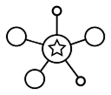
The Forum supports organisers in the preparatory phase and during the collection of signatures of your initiative!
LEARN
DISCUSS
CONNECT
SEEK ADVICE

Slide 9
A great tool for organising your initiative
Learn Section: Webinars, Guidance Notes, Learning Material
Blogs
Discuss
Seek Advice: if you need campaigning or fundraising advice during your campaign

Slide 10
European Citizens’ Initiative Forum
An essential tool for (potential) organisers where you are able to get practical information, advice and discuss any topics related to ECI’s
Aims to support active citizen participation
Learn
Collaborate

Slide 11
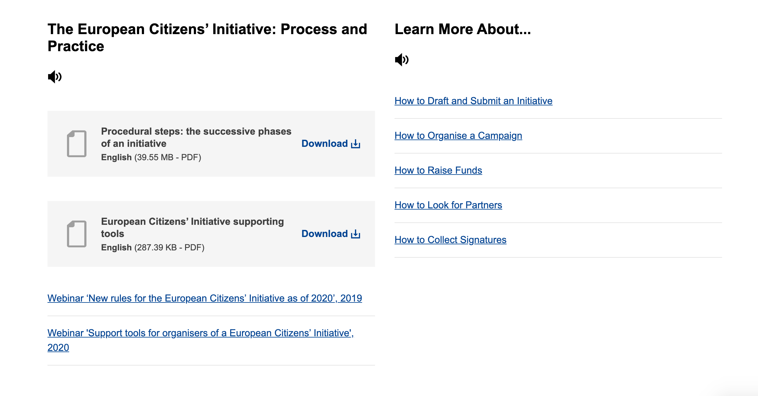
https://europa.eu/citizens-initiative-forum/learn_en
LEARN
Webinars
Guidance Notes
Success Stories
Testimonials
Notes:
Learn – this is where you will find webinars, guidance notes, success stories and testimonials from other ECI organisers

Slide 12
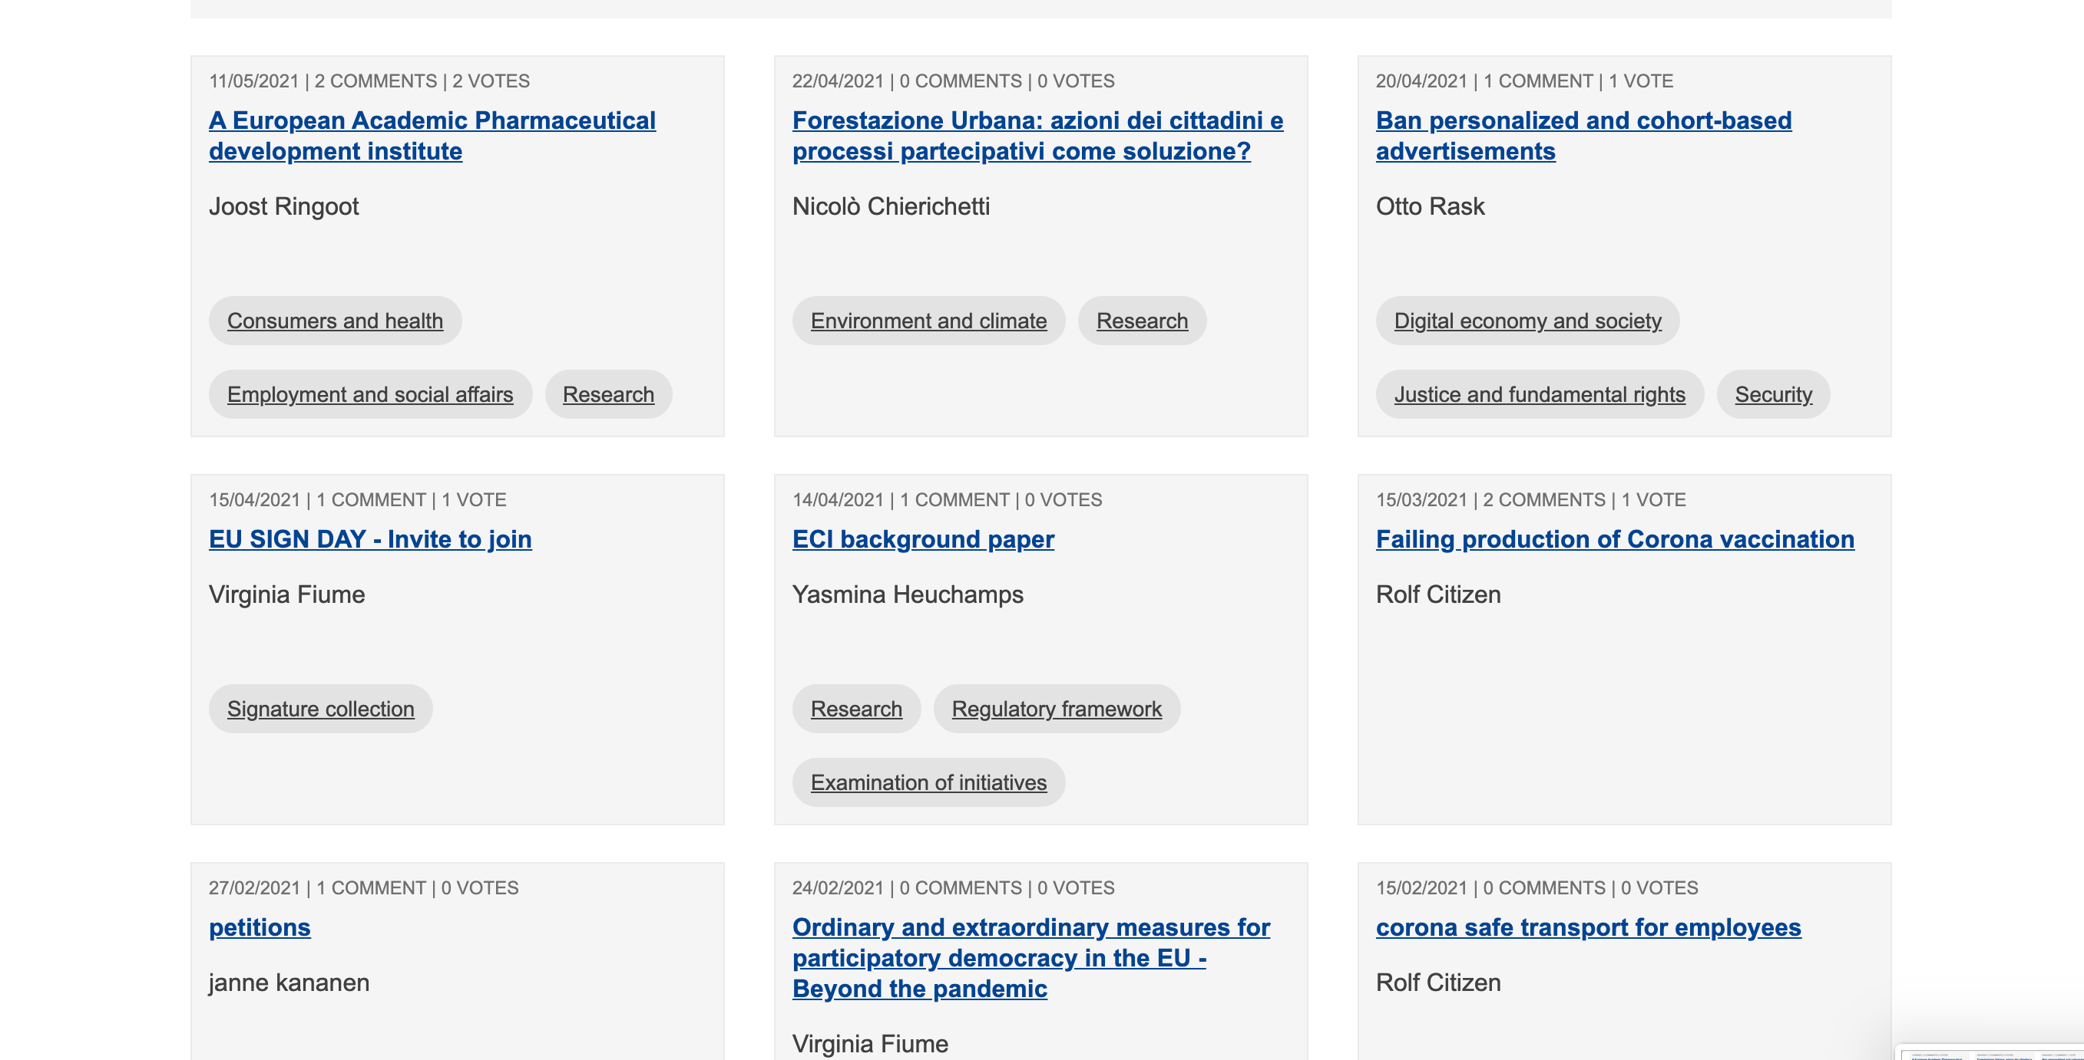
https://europa.eu/citizens-initiative-forum/discuss_en
DISCUSS
Notes:
Discuss – citizens can post their ideas and interact with other citizens

Slide 13
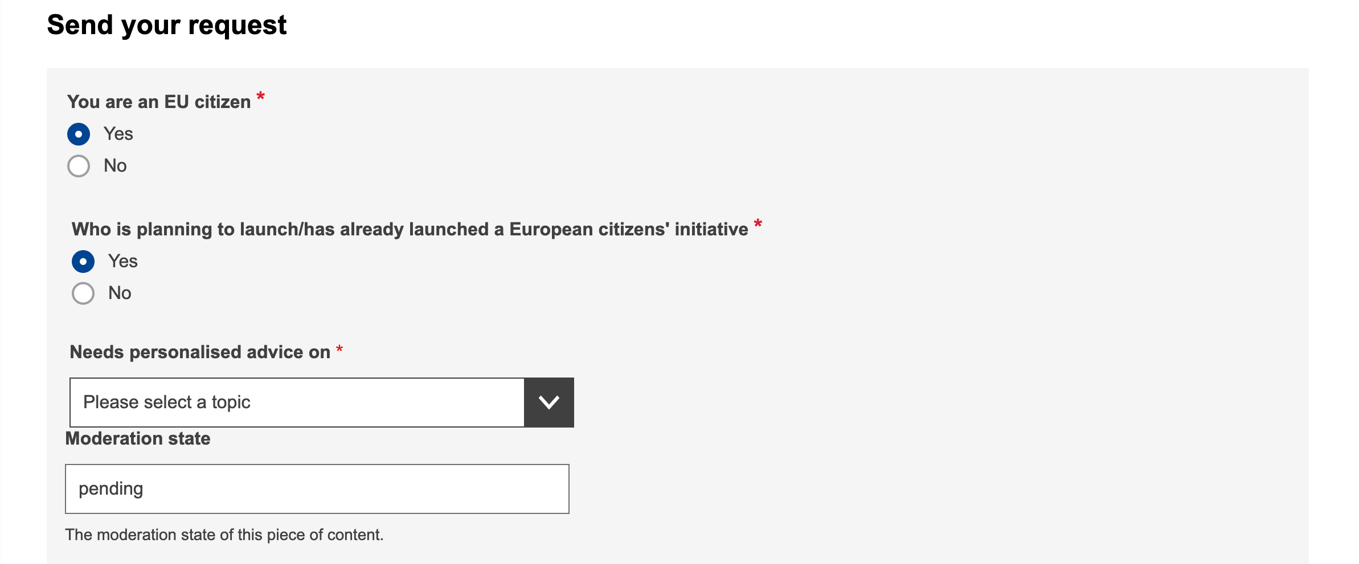
https://europa.eu/citizens-initiative-forum/seek-advice_en
SEEK ADVICE
Legal
Campaigning
Fundraising
Other
Notes:
Seek Advice – arguably the most important aspect of the Forum, this is where you can get free legal, campaign, fundraising and any other advice on your ECI

Slide 14
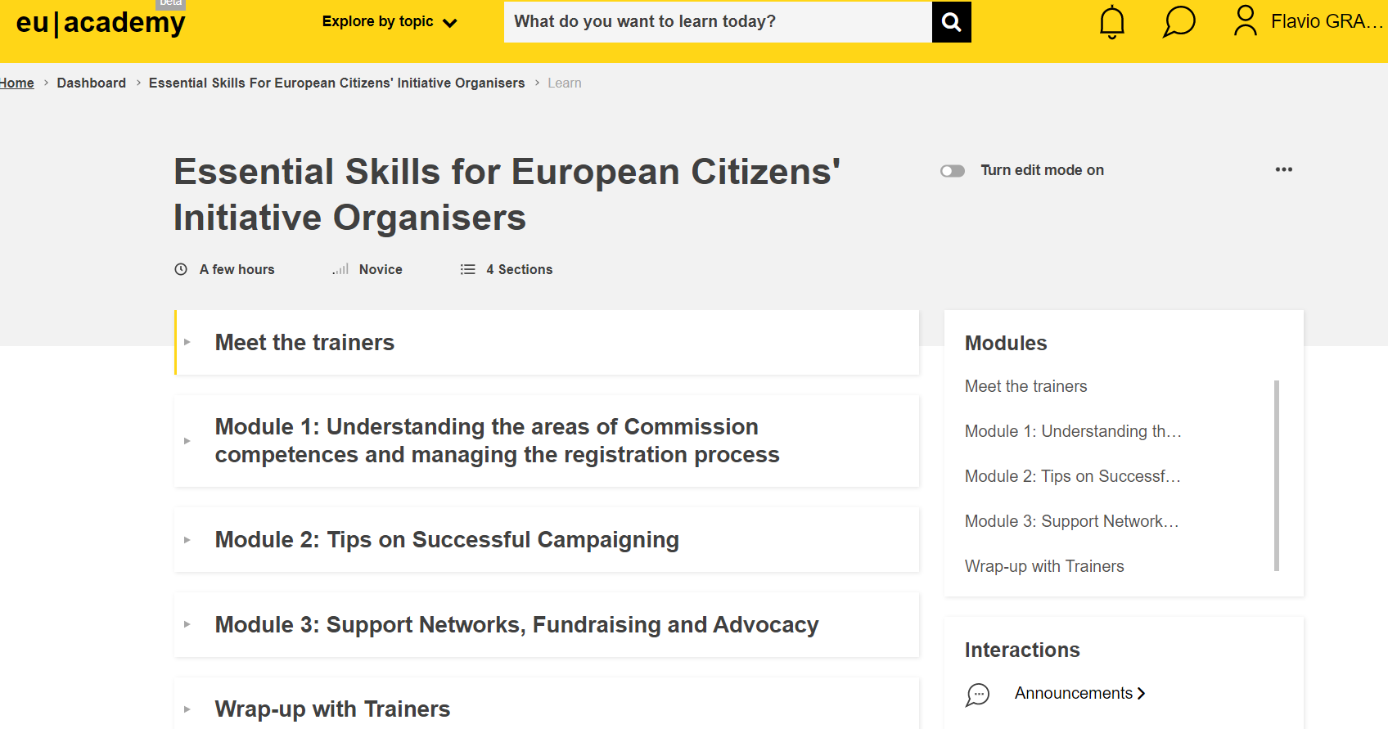
Innovative Material around the ECI
Newsletter - Online Course – Podcast Series – ECI Ambassadors

Slide 15
Questions received on the ECI Forum
Is an ECI targeting a change of Article 128 of TFEU something which falls within the framework of the Commission’s power?
If the text of ECI consists of more than one demand and one of them falls not under the framework of the Commission’s power, can the Commission reject the whole ECI or rejects only this certain demand and accepts rest demands?
Is it possible in the course of the signature collection period to adjust the petition e.g.: - by changing wording or by adding new demands?

Slide 16
Now that your initiative is launched....
Introduction
Understanding the areas of Commission competences and managing the registration process - Practical aspects of the ECI and what the ECI Forum is.
Campaigning for a European Citizens' Initiative - what has worked well, what needs to be improved.
Support Networks, Fundraising and Advocacy – how to reach 1 million signatures.
Q&A – Interactive Discussion

Slide 17
A Pan-European Campaign: be prepared it is not easy

Slide 18
How to reach the 1 million signatures
Quotas per member state
Around 2700 on average per day. (!) be aware of that.
National campaigns: keep them updated if other member states reached the threshold (motivating and supporting effect)
Target more than 1million signatures → around 10% could be invalid
Build the campaign(s) on your strengths

Slide 19
Collecting signatures - Overview
You will have 6 months from the date of registration of your initiative to decide when to begin the one-year collection of statements of support.
You will need to inform the Commission of the chosen date at the latest 10 working days before that.
Signatories need to be EU citizens and old enough to vote in European Parliament elections (age 18 except for Austria (16), Malta (16), Greece (17) and Estonia (16)) - unless the Member State has decided to lower the minimum age for signatories to 16 and has informed the Commission accordingly.
You can collect signatures on paper & online

Slide 20
Some statistics
10 | 4 | 1
Collection Ongoing | To start collection soon | Final outcome to be reported/pre-verification stage
Initiatives open for signatures | Registered initiatives which should start collection of signatures | Collection period completed; awaiting information from organisers about the outcome or for the organisers to launch their verification process
95 Registered Initiatives
6 Answered Initiatives
111 Registration requests
3 Verification ongoing
4 Collection Closed

Slide 21
Critical Points to Reflect Upon
Awareness of the tool – increase in recent years
Difficulties of the campaign
Impact
Reflection on what is happening in Europe (Environmental Issues, Pandemic, corruption, minorities, etc.)
Notes:
The ECIs are a reflection on what is happening in Europe

Slide 22
Questions received on the ECI Forum
What happens if a voter signs more than once an ECI? This can happen if e.g. she/he forgets what he did months ago. Are then all signatures of this person invalid or at least only one vote is counted? One vote counts
How it is ensured, that person A cannot vote for Person B?
It is very difficult to gather 1 million signatures, so every vote is very precious. And we know that in every ECI more than 5% or even 10% are declared invalid? Why this happens and what an ECI organizer can do in order to reduce the number of invalid signatures?

Slide 23
Outline of today’s webinar
Introduction
Understanding the areas of Commission competences and managing the registration process - Practical aspects of the ECI and what the ECI Forum is.
Campaigning for a European Citizens' Initiative - what has worked well, what needs to be improved.
Support Networks, Fundraising and Advocacy – how to reach 1 million signatures.
Q&A – Interactive Discussion

Slide 24
Thank you very much for joining us today!

